Slide 1
CSCI2100D Tutorial 5 Pointer Implementation of Binary Tree
Qintian GUO
Department of Systems Engineering and Engineering Management
Chinese University of Hong Kong
Tutorial 5

Slide 2
Outline
Basic Structures
Pointer Implementation of Binary Tree Functions
Tutorial 5

Slide 3
Outline
Basic Structures
Implementation of Binary Tree Functions
Tutorial 5

Slide 4
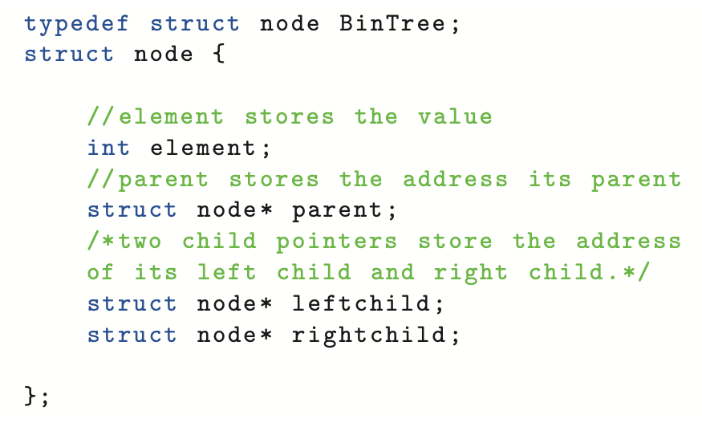
Node Definition
A
B
D
E
I
parent
leftchild
rightchild
(Omitted links points to NULL)
Tutorial 5

Slide 5
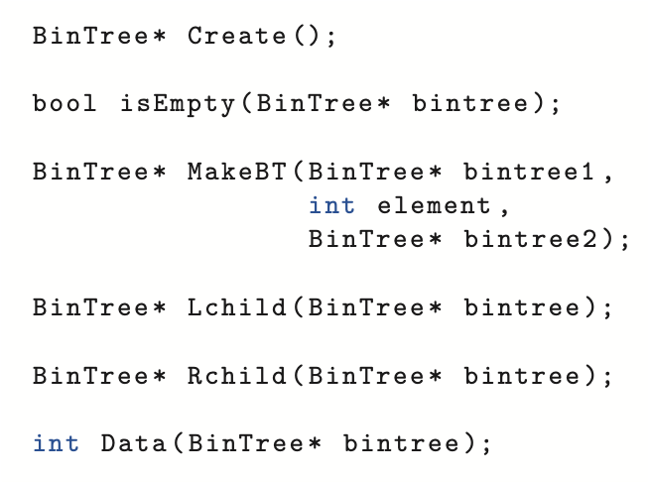
Overview of Functions from BinaryTree
Tutorial 5

Slide 6
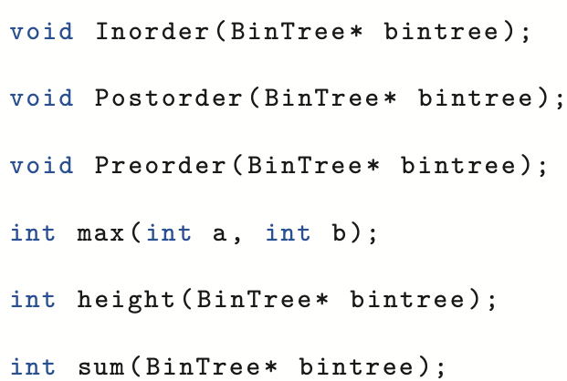
Overview of Functions from BinaryTree
Tutorial 5

Slide 7
Outline
Basic Structures
Implementation of Binary Tree Functions
Tutorial 5

Slide 8
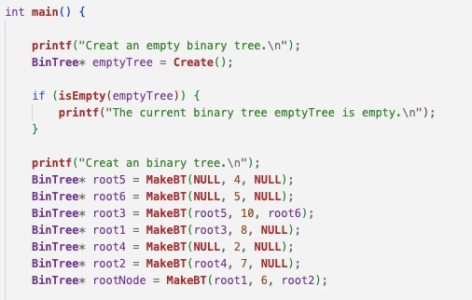
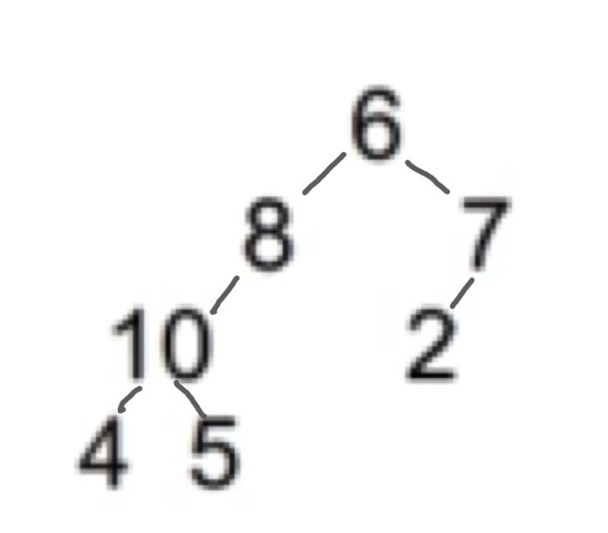
Overview of Main Function
Tutorial 5

Slide 9
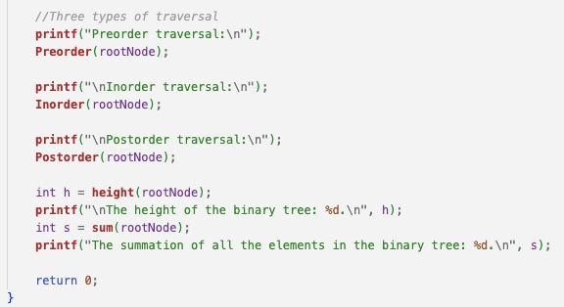
Overview of Main Function
Tutorial 5

Slide 10
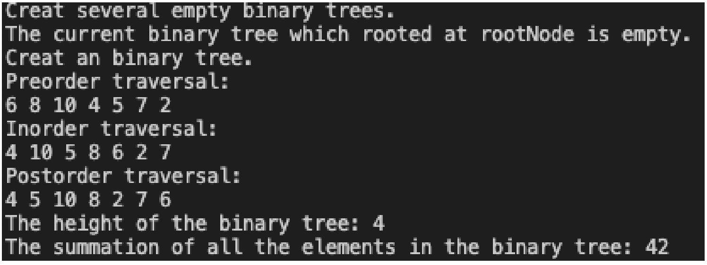
Output
Tutorial 5

Slide 11
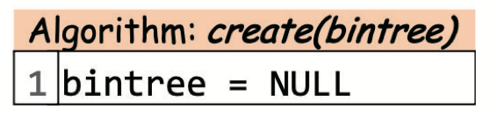
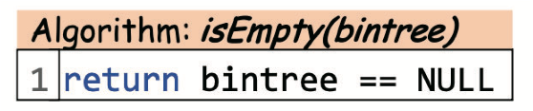
Create & IsEmpty
Tutorial 5

Slide 12
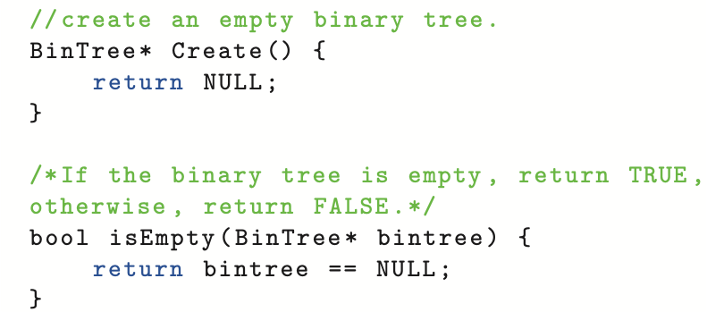
Create & IsEmpty
Tutorial 5

Slide 13
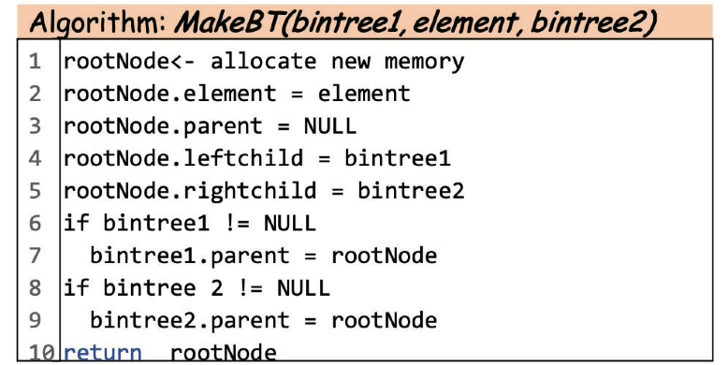
Construct Binary Tree
Tutorial 5

Slide 14
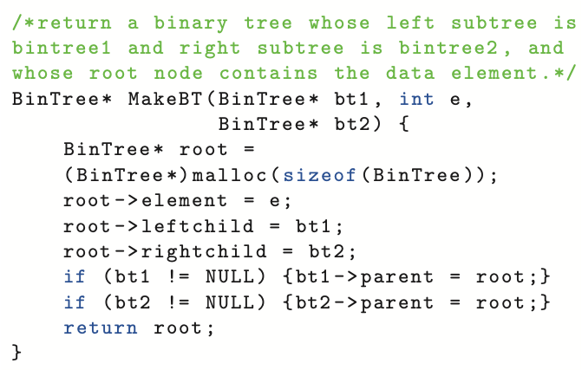
Construct Binary Tree
Tutorial 5

Slide 15
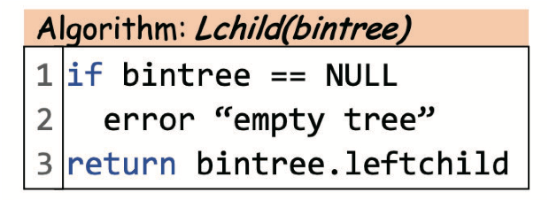
LChild:
Tutorial 5

Slide 16
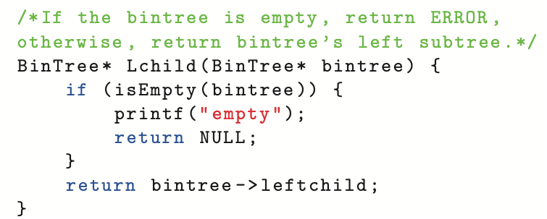
LChild:
Tutorial 5

Slide 17
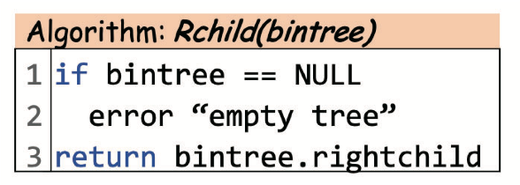
RChild:
Tutorial 5

Slide 18
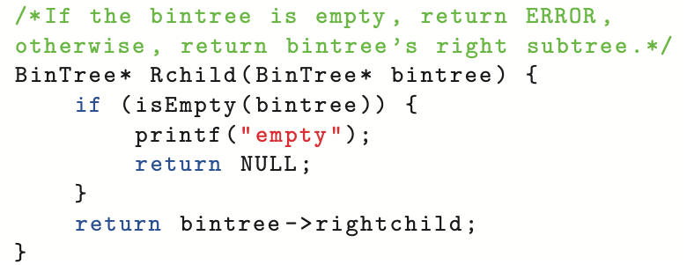
RChild:
Tutorial 5

Slide 19
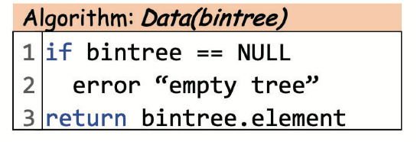
Data:
Tutorial 5

Slide 20
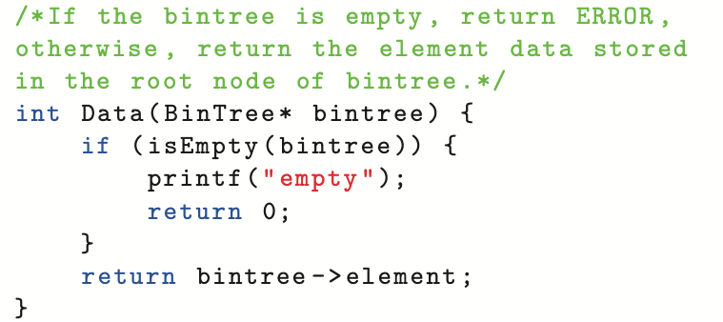
Data:
Tutorial 5

Slide 21
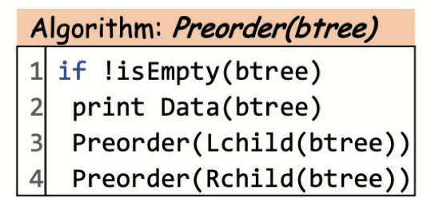
Preorder Traversal:
Preorder traversal:
First visit the root node;
Preorder traverse the left-subtree;
Preorder traverse the right-subtree.
Tutorial 5

Slide 22
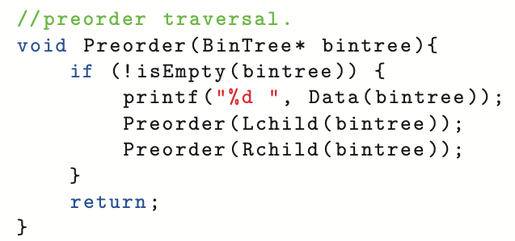
Preorder Traversal:
Tutorial 5

Slide 23
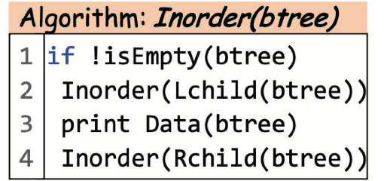
Inorder Traversal:
Inorder traversal of a binary tree works as follows:
Inorder traverse its left-subtree;
Then visit the root node;
Finally inorder traverse the right-subtree.
Tutorial 5

Slide 24
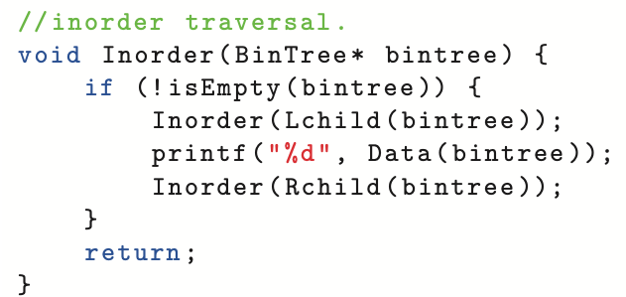
Inorder Traversal:
Tutorial 5

Slide 25
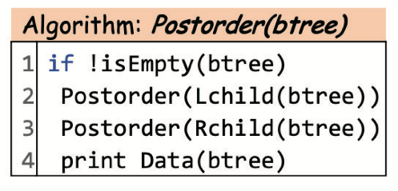
Postorder Traversal:
Postorder traversal:
Postorder traverse the left-subtree;
Postorder traverse the right-subtree;
Finally, visit the root node.
Tutorial 5

Slide 26
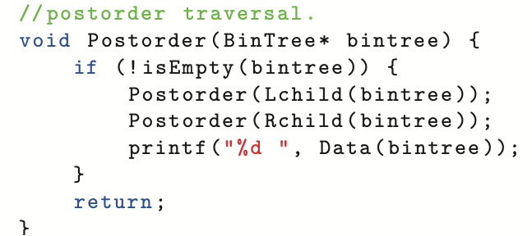
Postorder Traversal:
Tutorial 5

Slide 27
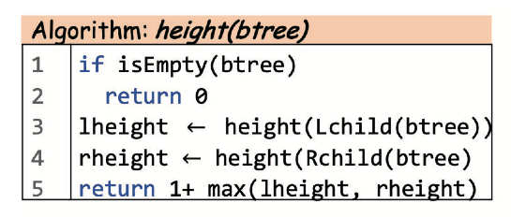
Height
Tutorial 5

Slide 28
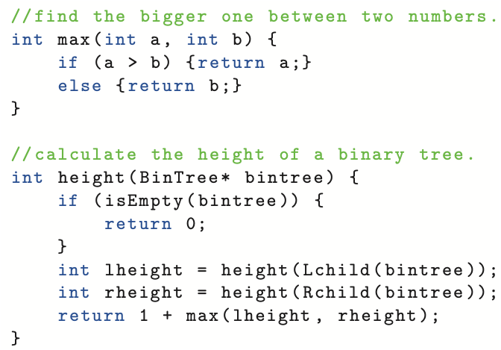
Height
Tutorial 5

Slide 29
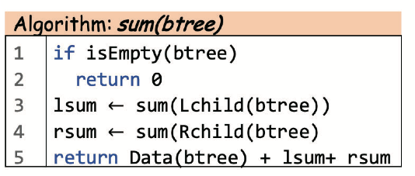
Sum
Tutorial 5

Slide 30
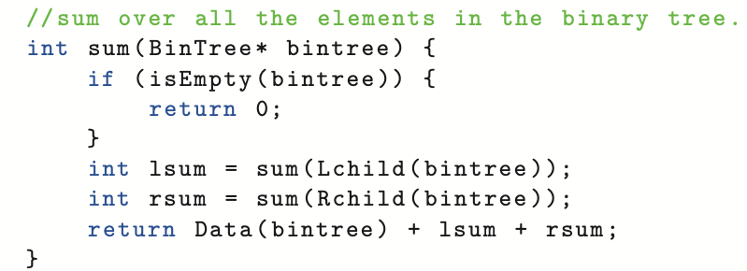
Sum
Tutorial 5

Slide 31
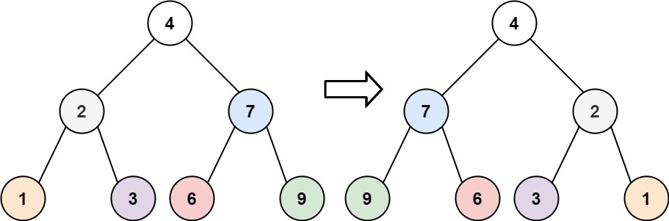
Invert binary tree
Given the root of a binary tree, invert the tree such that the left and right children of all non-leaf nodes interchanged.
Tutorial 5

Slide 32
Invert binary tree
Recursion
For the current node, swap its left and right children.
Invert the left and right subtrees
Tutorial 5

Slide 33
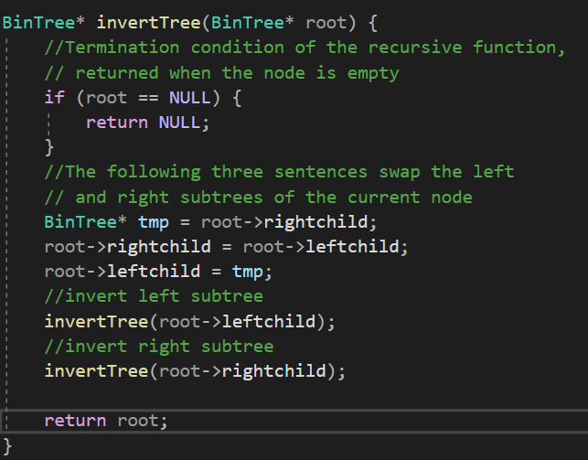
Invert binary tree
Recursion
Tutorial 5

Slide 34
Invert binary tree
Iteration
Enqueue the nodes in the tree into a queue level by level
iterate over the queue
Tutorial 5

Slide 35
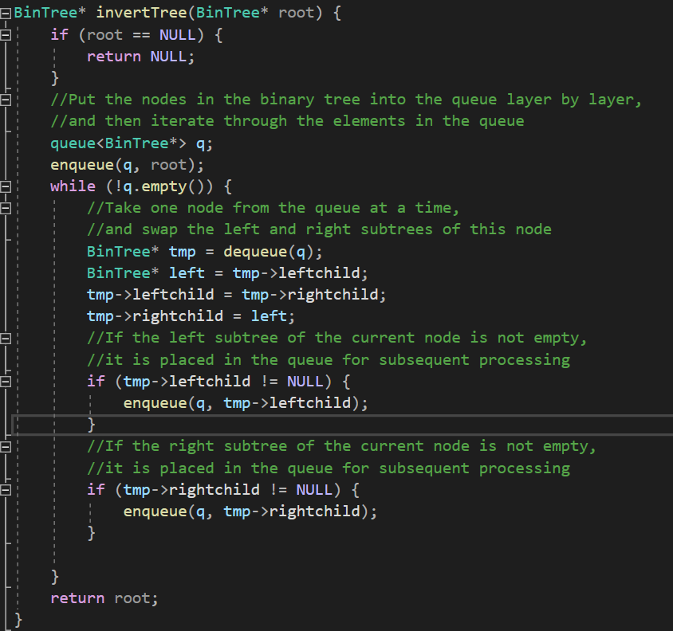
Invert binary tree
Iteration
Tutorial 5

